Slide 1

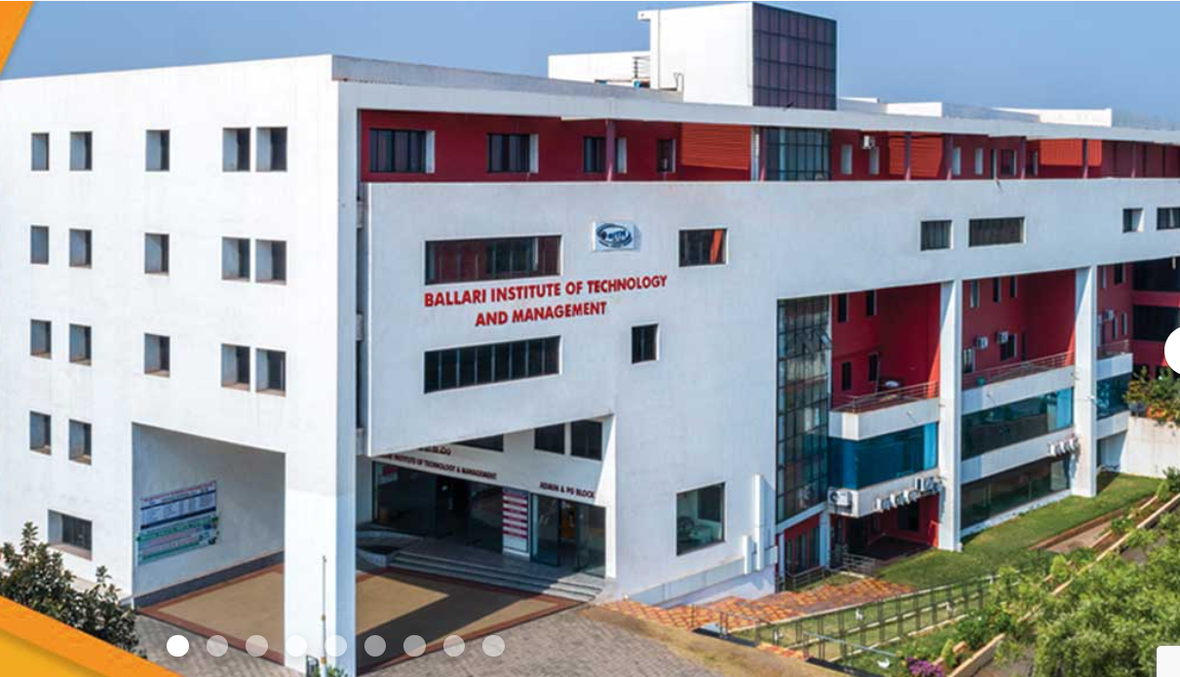
BALLARI INSTITUTE OF TECHNOLOGY AND MANAGEMENT
DBMS MINI PROJECT

Slide 2

DBMS PROJECT ON
EMPLOYEE MANAGEMENT SYSTEM
BY
S Manikantaswara Reddy
Rohtih B
Sai Prasad Reddy G

Slide 3

INTRODUCTION :
This is a typical Employee management system which maintains the information about the personal and official details of the employees. It is developed to override the problems of practicing manual system and reduces the Paper Work. It is a distributed application, developed to maintain the details of employees working in any Organization.

Slide 4
ABSTRACT :
The objective of this project is to provide a simple approach towards the management of employee information. And to develop a well designed database to store employee information. Also this project aims to simplify the task of maintaining records of the employees of any Enterprise.
Employee Management System is a mini project built using HTML, CSS, PHP and MYSQL database. Acts as a Tool to manage inner operations of a company related to employee details, salary, leave and many more.

Slide 5
SL NO | ITEM | REQUIREMENT | RESPONSIBILITY | STATUS
1) | Software | VS code , XAMPP server, | TEAM | COMPLETED
2) | Document | MS word | TEAM | COMPLETED

Slide 6
HARDWARE REQUIREMENTS :
PC with Quad core or above.
4GB RAM or above.
180 GB HARDDISK OR ABOVE.

Slide 7
SOFTWARE REQUIREMENTS :
Operating System: Windows 7 (or Latest).
VS CODE , XAMPP SERVER APPLICATION
MS Word And PowerPoint.

Slide 8

ADMIN MODULE:
Admin includes the following
operations which defines the functionality of
admin:-
Add Employee
View Employee
Assign project
4. Project Status
5. Salary Table
6. Employee Leave

Slide 9

EMPLOYEE MODULE:
Employee has few operations like:
Check his profile.
List of Projects submitted.
Apply Leave

Slide 10
OUTPUTS :- STEP 1:
In the first step it is the HOME SCREEN ,
And then Next which says about the title of the project and the members involved in developing it.

Slide 11
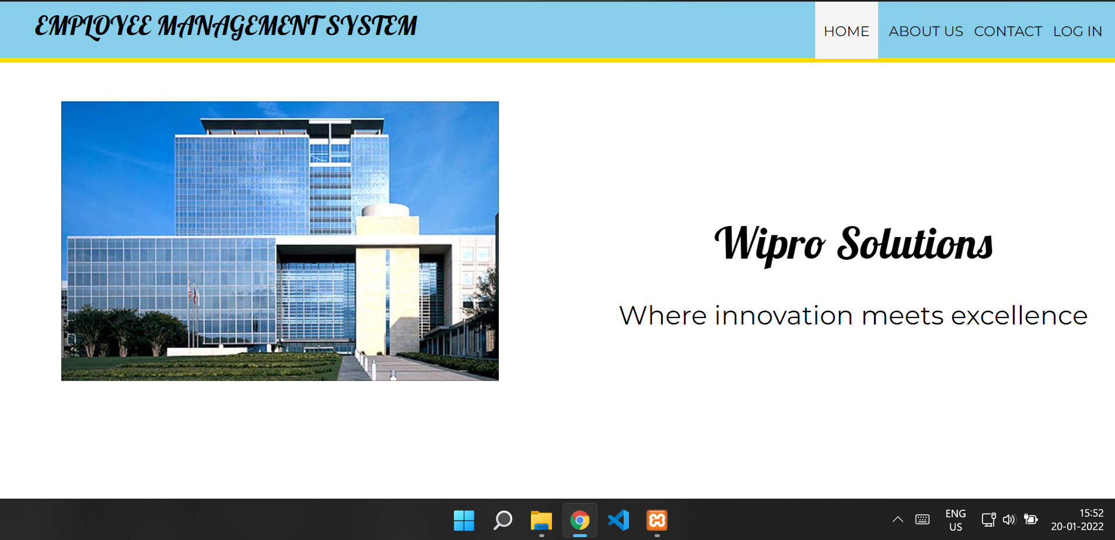
HOME SCREEN:

Slide 12
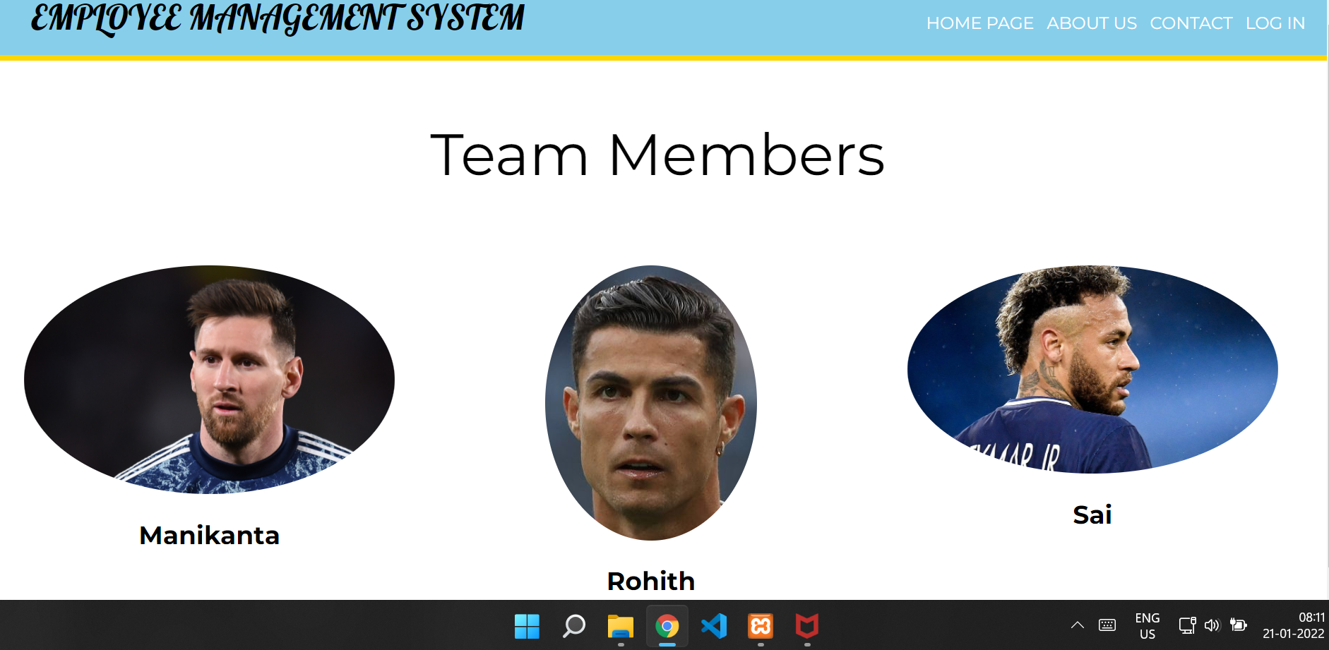
TEAM MEMBERS:

Slide 13
STEP 2:
Now we will login as Admin or Employee (Login Page)
Admin :The system will verify the Admin with his/her registered Email and password, then it will take to the admin portal.
Employee: The system will verify the Employee with his/her registered Email id and password, then it will take to the Employee portal.

Slide 14
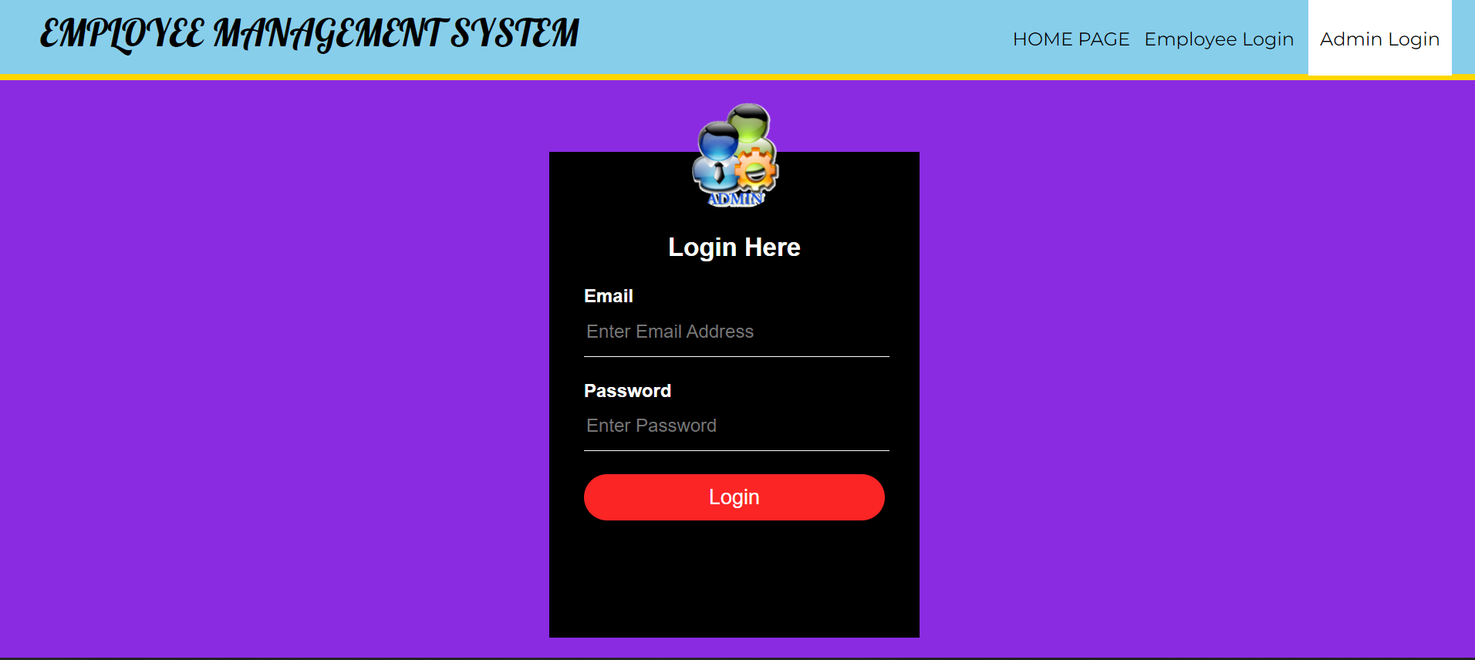
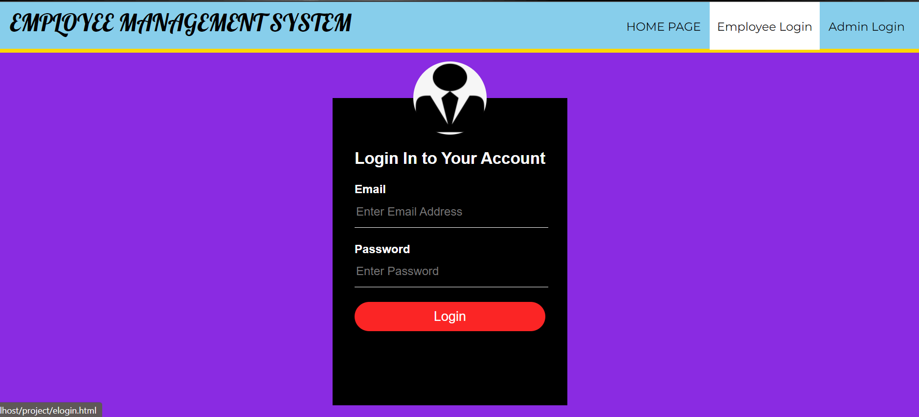
1. Admin Login
2 . EMPLOYEE LOGIN

Slide 15
STEP 3:
If the user successfully logged in as admin ,system will show a list of operations such as: Adding a new employee ,view employee, assign project, Employee Leave etc.
If the user successfully logged in as employee ,system will show a list of operations such as: My Projects , Applying for a leave etc.

Slide 16
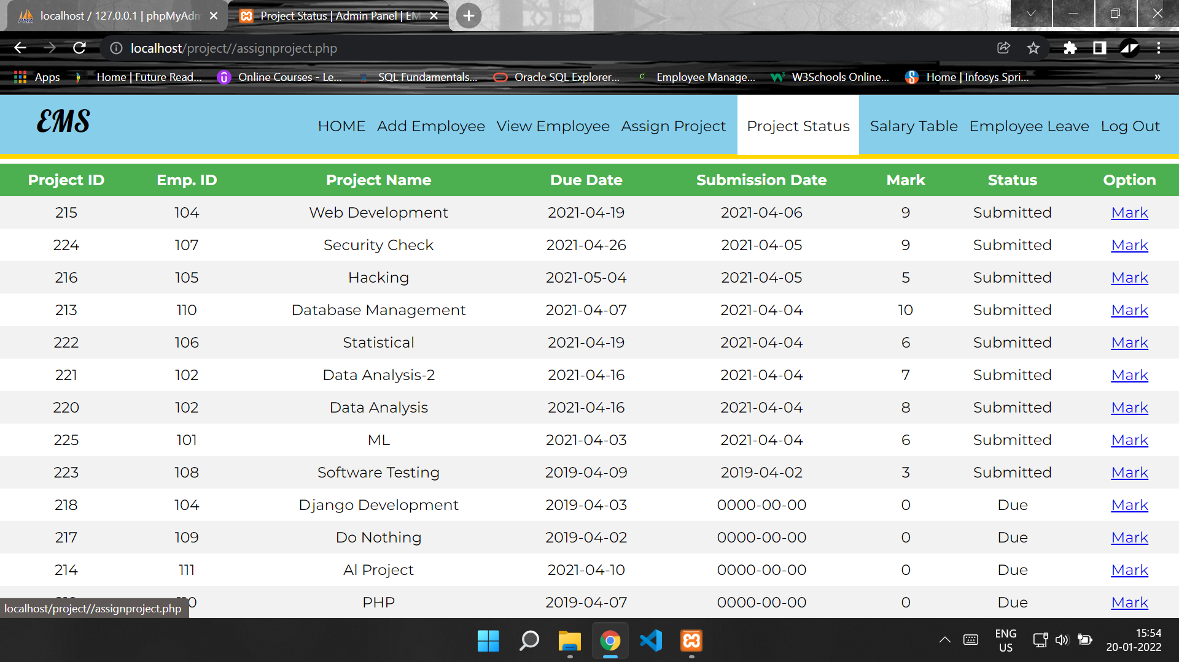
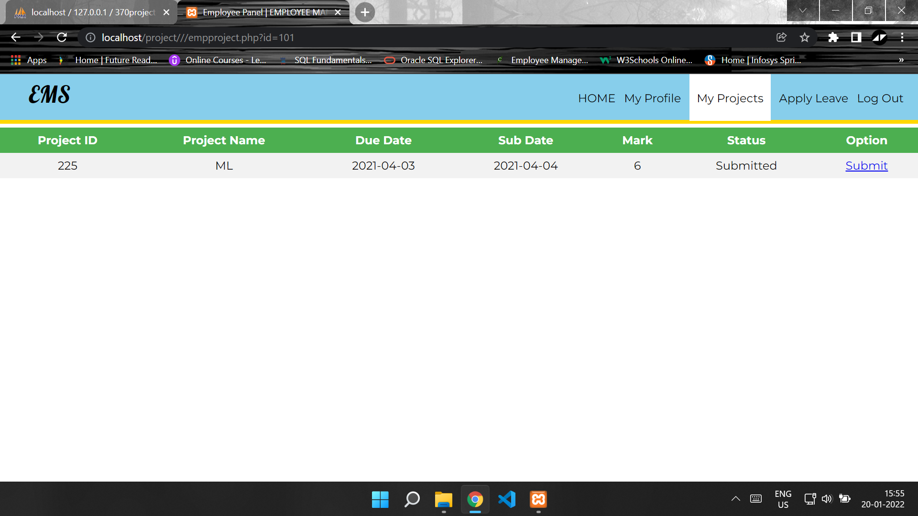

Slide 17
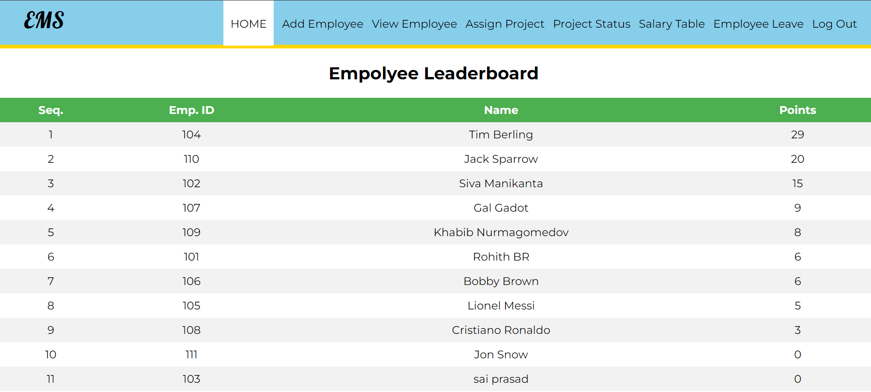
EMPLOYEE LEADERBOARD

Slide 18
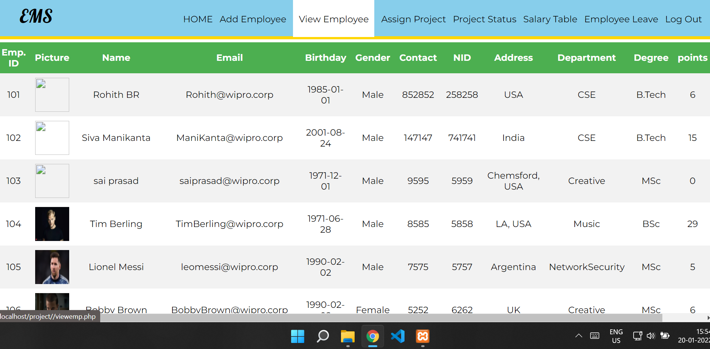
LIST OF EMPLOYEE’S

Slide 19
The conclusion
Provides Computerized System for maintaining records.
The system is more efficient and reliable.
Avoids human errors and efforts for maintaining daily data. Also avoids data inconsistency and redundancy.
It has no hidden costs and fairs

Slide 20


